Slide 1
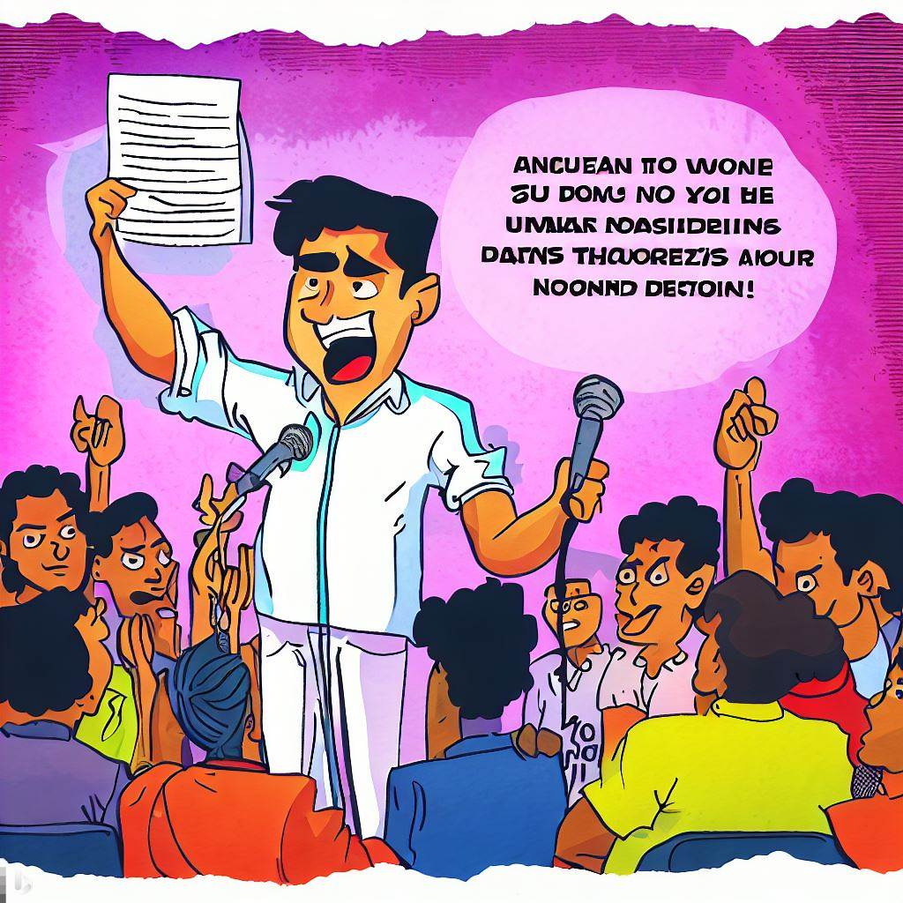
A+

Slide 2
A+
Jesus, I’ve followed all the rules so don’t I deserve eternal life?

Slide 3
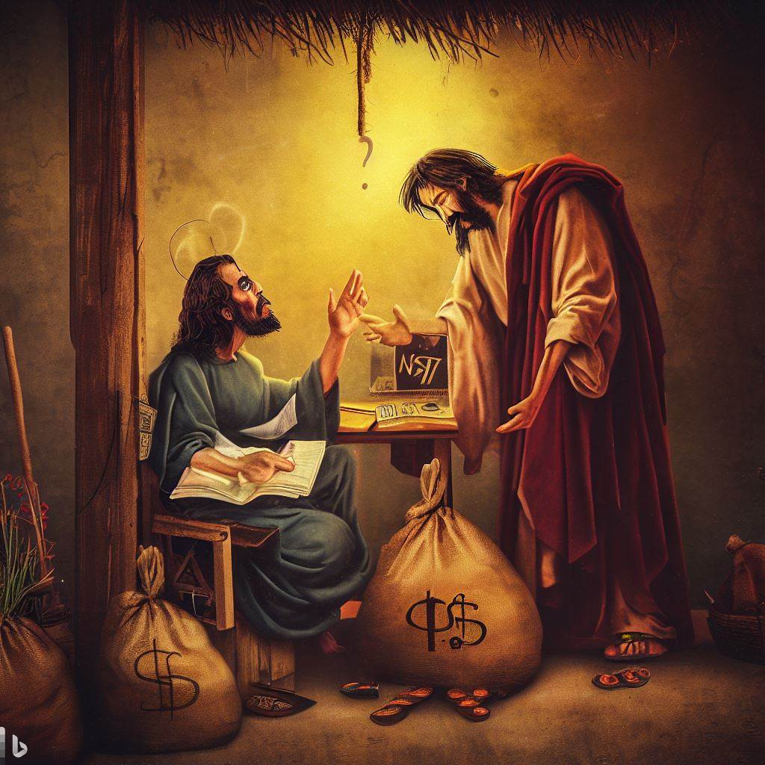
$
$

Slide 4
What did the man treasure?
Jesus
Wealth
$
$

